Slide 1

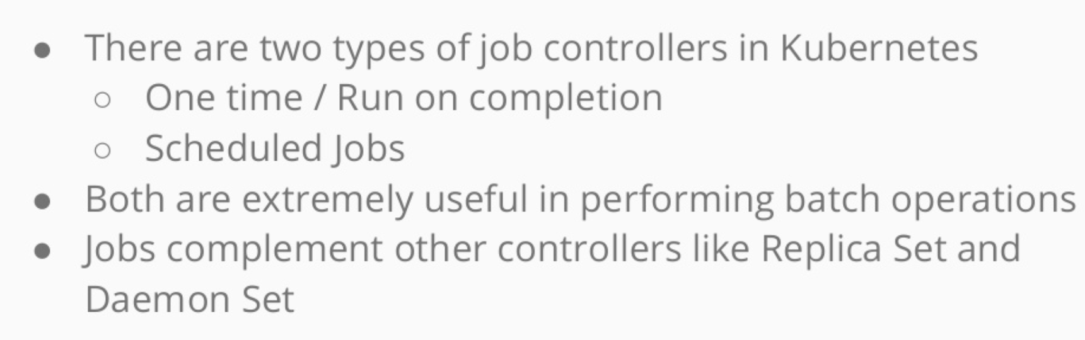
Jobs and Cronjobs

Slide 2
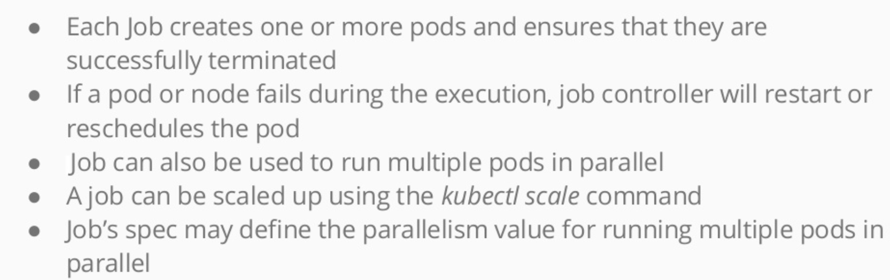
Jobs and cronjobs

Slide 3
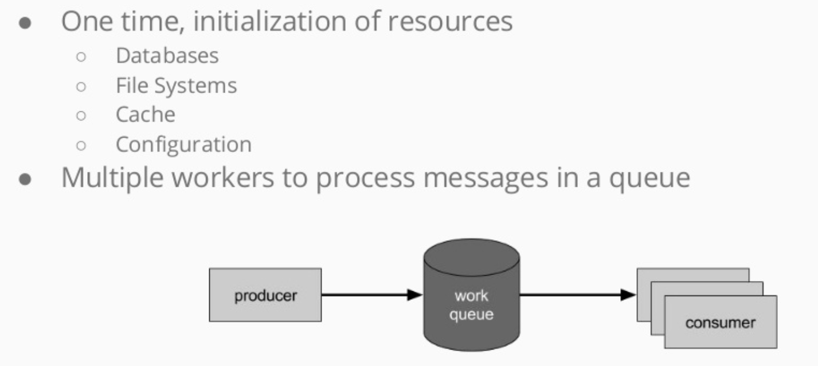
Use case of Jobs

Slide 4
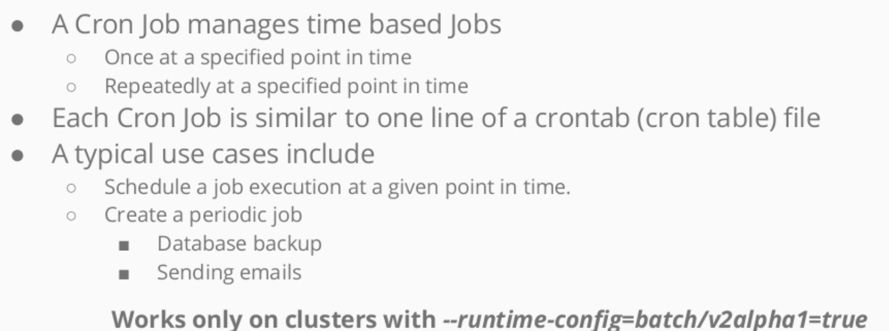
Jobs and cronjobs

Slide 5


